Slide 1
Course Development Process
Kim Henry

Slide 2
Objectives
By the end of this session, participants should be able to:
Describe the three primary aspects of determining the scope of a course.
Identify the members of a typical course development team and describe the role of each member.
Identify strategies for organizing project information.
Relate key activities to course development processes and workflow.

Slide 3
Defining the Project

Slide 4
Defining the Project
Clearly state all of the project goals.
Articulate the high-level specifications for the course.
Scope
determine overarching, big-picture learning objectives
identify primary topics
Sequence
order the primary topics
identify and organize second-level sub-topics
Learning Objectives
write student-centered, measurable learning objectives for each sub-topic

Slide 5
Identifying Team Members and Their Roles

Slide 6
Project Manager
Create and manage timelines, work assignments and deliverables.
Keep team members and stakeholders informed on progress.
Initiate and maintain regular communication with all team members.
Work with SMEs to develop a course framework.
Establish course organization.
Coordinate the implementation of materials into the OLI Platform.

Slide 7
Course Developer
Review course materials and ensure proper alignment between objectives, activities and assessments.
Identify places for and manage the development of activities including unique activities and media.
Assist in the implementation of materials into the OLI platform.

Slide 8
Learning Scientist
Consult on learning design.
Produce model for the Learning Dashboard.

Slide 9
SME/Core Author(s)
Determine course objectives.
Create learning materials that reflect OLI principles
Expository text
Activities
Assessments
Revise materials based on reviewer feedback.
Review and provide feedback on course materials created by other authors.

Slide 10
SME/Review and Contribute
Review and provide feedback on course materials prepared by core author(s).
Assist in writing assessment questions.
Assist in writing activities.

Slide 11
Coders
Given completed or nearly completed design documents, implement material into OLI Platform.
Review and make minor edits on material being implemented.
Fix identified errors in xml documents.

Slide 12
Organizing Project Information

Slide 13
Course Website
Design Documents
General Information
Resources
Error Report Form
PM/CD Templates

Slide 14
Developing the Course

Slide 15
Developing the Course
Develop and Design
refine learning objectives
write assessment questions
write activities
write expository material
Implement
code pages and activities
Integrate images, videos, and other content
Test and Review
evaluate current implementation of course
identify changes and corrections

Slide 16
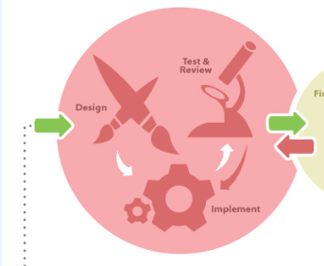
Developing the Course…

Slide 17
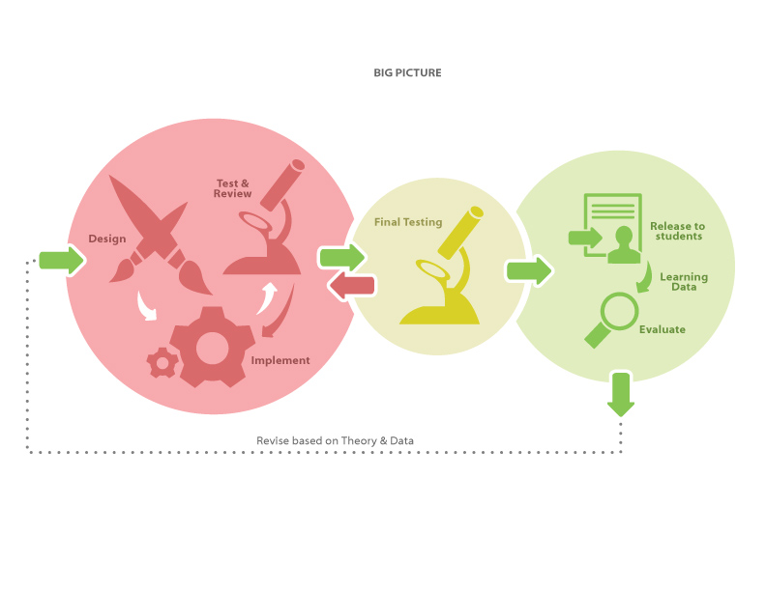

Slide 18
Have fun… Enjoy the process… May you experience success with your projects!

Slide 19
STEM Readiness Core Skills Course

Slide 20
Goal
Produce a 45 hour OLI-STEM Readiness Core Skills Course that will assist participants in identified technical programs in improving the necessary core skills including math, communication and professionalism required to be successful in the programs and ultimately to assist the students in acquiring and maintaining employment in a STEM related career.

Slide 21
Pathways
Mechatronics
Composites Material Technology
Cyber Technology
Electric Vehicle Technology
Environmental Technology

Slide 22
Core Skills
Math
Communication
Professionalism
Contextualized Cased-based Modules
Integrated topics throughout the course
The Big Picture of Critical Thinking/Problem Solving incorporated throughout the course.
Course Approach

