Slide 1
Platform+: The Big Picture
John Rinderle

Slide 2
What is a “big picture”?
Conceptual map of the domain
Shows the relationship between concepts in a course
Why is this important?
The way students organize knowledge determines how they use it.

Slide 3
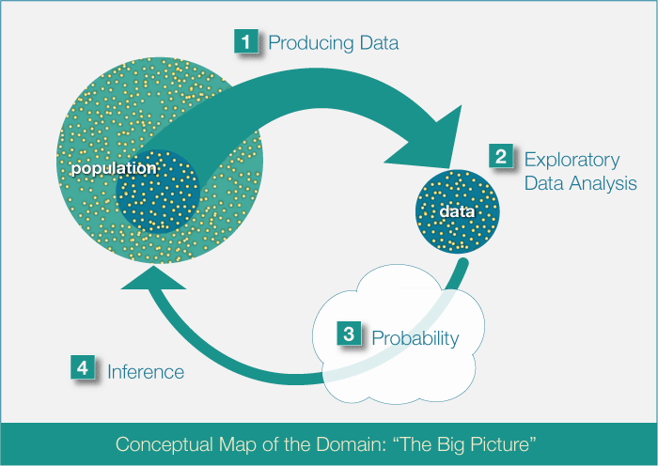
What is a “big picture”?

Slide 4
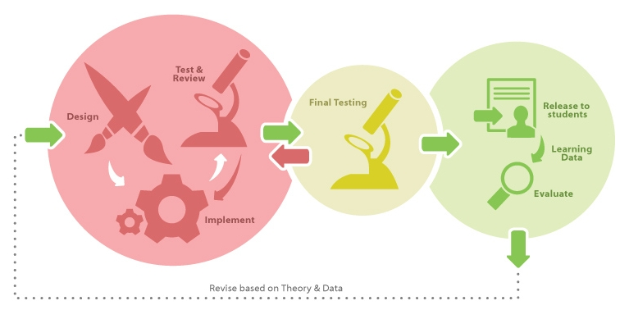
Platform+: Big Picture

Slide 5
Phases of Development
Development : design and implement course content, using a shared server with individual project space
Quality Assurance (QA) : test the course content for subject matter accuracy, instructional design, and functioning technology
Production : course available to instructors and students, collect learning data for evaluation, large scale and stable server

Slide 6
By the end of the workshop…
You will have created your first OLI module
Design learner centered content with UDL affordances
Design activities for data collection and feedback
Create and publish content to the OLI platform
Know where and how to get support
Implement a workflow and project plan to support your work

Slide 7
Agenda
Day 1 : Effective Learning Design
Creating Content Pages
Publishing and Previewing
Day 2 : Practice and Assessment
Day 3 : Data Driven Improvement
Learning Dashboard

Slide 8
Developer Website
http://community.oli.cmu.edu/

