Slide 1
Authoring with OLI Author
Greg Goodhile

Slide 2
What is OLI Author?
An authoring tool to easily create Inline Tutor & Linked Assessment documents, which are comprised of common question types.
These finished documents are then added to an OLI course to create interactive activities. The most common activities report to the dashboard are created from one of these two document types.
Download URL: http://oli.cmu.edu/tools/oliauthor/

Slide 3
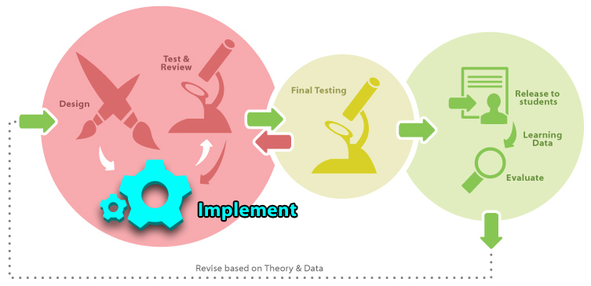
‘The Big Picture’ – Implementation
The authoring process is part of the Implementation Phase. This assumes that good learning designs for activities were already created during the Design Phase.

Slide 4
Objectives
By the end of this session, you should be able to:
Identify document & activity types
Inline Tutor
Learn-By-Doing (LBD)
Did-I-Get-This (DIGT)
Linked Assessment
Checkpoint
Quiz
Identify various question types
Create a LBD activity for your course
Checkpoints and Quizzes report to the Gradebook.

Slide 5
Activity Types
Inline Tutor Activities:
Learn-By-Doing: These activities give students an interactive way to learn new material and receive guided practice without being graded. Immediate feedback is given to help refine the student’s understanding of what they are learning.
Did-I-Get-This: These activities offer the opportunity for students to evaluate their understanding after a lesson. Again, this activity is not graded.
Supported XML Tags: p, em, sub, sup, link, image, flash
File Directory: content/x-oli-inline-assessment/
Linked Assessment Activities:
Quiz & Checkpoint: These activities usually fall at the end of a section or module, and are a way for instructors to assess students' mastery of the concepts they learned.
Supported XML Tags: All tags that Inline Tutors support, plus table, list, mathml, audio, video, example, definition, and much more.
File Directory: content/x-oli-assessment2/

Slide 6
Question Types
Multiple Choice: A list of answer choices.
Short Answer (Submit & Compare): Answers are to be given in sentence or paragraph form and will be reviewed by an instructor.
Numeric: Answer is given as a number.
Text: Answer is a word or simple phrase.
Unknown Question Type: If a document is opened by OLI Author and the question type is unknown, this will be the selected question type. This will also be used if a question has multiple parts. Typically, you will never use this question type.

Slide 7
Steps to create a LBD activity
SVN UPDATE your local course copy if you haven’t already
Create an Inline Tutor document with OLI Author
Save the document within your local course copy in the content/x-oli-inline-assessment/ folder
SVN ADD the newly created document
Embed code snippet
Click the “Embed” button
Select the “Learn-By-Doing” radio button
Click the “Copy Code” button
Paste the code snippet into your workbook page
SVN COMMIT your local course copy
Republish your course and view your activity

Slide 8
Summary
OLI Author is a helpful tool for creating common question types. There are other question types that can be created, but one would need to use an XML editor, such as Oxygen. Two other question types that can be created using Oxygen are Fill-in-the-blank and Image Hotspot.
Learning objectives, hints, feedback, and overall question design, should be determined during the Design Phase and not during the Implementation Phase.

