Slide 1
OLI Platform+ Workshop: Authoring Tools
John Rinderle

Slide 2
Agenda
Welcome and Introductions
Authoring for Platform+
Using Google Docs for OLI
Creating Tutors with OLI Author
Workshop Pre-Work
Test and Configure Your System
Help and Support

Slide 3
What are the benefits?
Design activities for practice and feedback.
State desired learning outcomes.
Use advanced assessment tools to create interactive practice activities.
Add hints and feedback to target student misconceptions and offer immediate feedback.
Access instructor feedback reports for a real-time view of student performance.

Slide 4
What are the benefits?
Capture data on student learning and behavior.
Track student actions through a course.
Identify areas where students succeed and struggle. Use data reports to focus efforts to refine materials for future students.
Measure effectiveness. Use data to evaluate the impact of the resources you create.
Notes:
The OLI platform tracks student actions through a course, including: respond to a question, receive feedback, ask for a hint, login, view a page, etc. Projects will receive access to summary reports and raw data.
Continuously improve. Identify areas where students succeed and struggle. Use data reports to focus your efforts to refine materials for future students.
Measure effectiveness. Take a scientific approach to course design. Use data to evaluate the impact of the resources you create.
Contribute to a virtuous cycle. Data improves our understanding of human learning which in turn allows us to build more effective instructional tools and practice. Join OLI and CAST in this community based research activity.

Slide 5
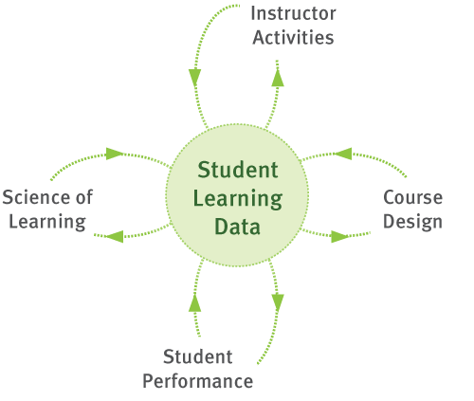
Data drives powerful Feedback Loops

Slide 6
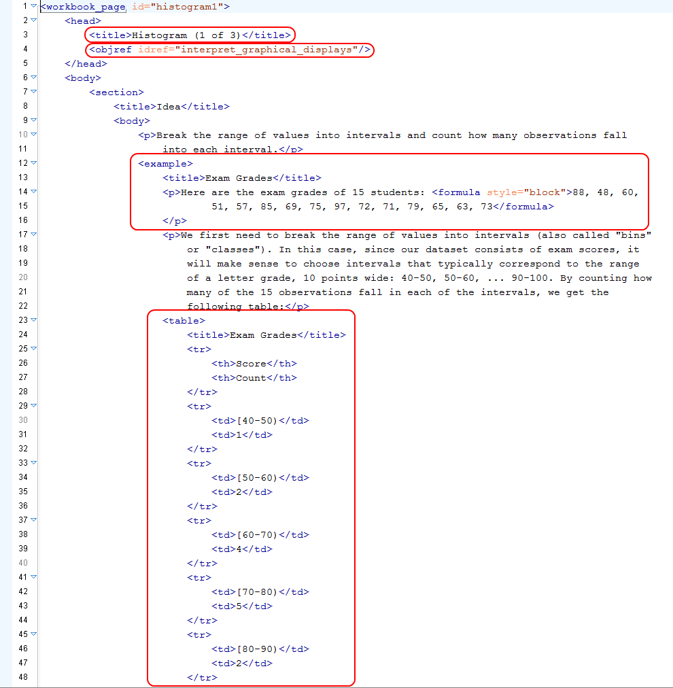
Platform+: XML Content

Slide 7
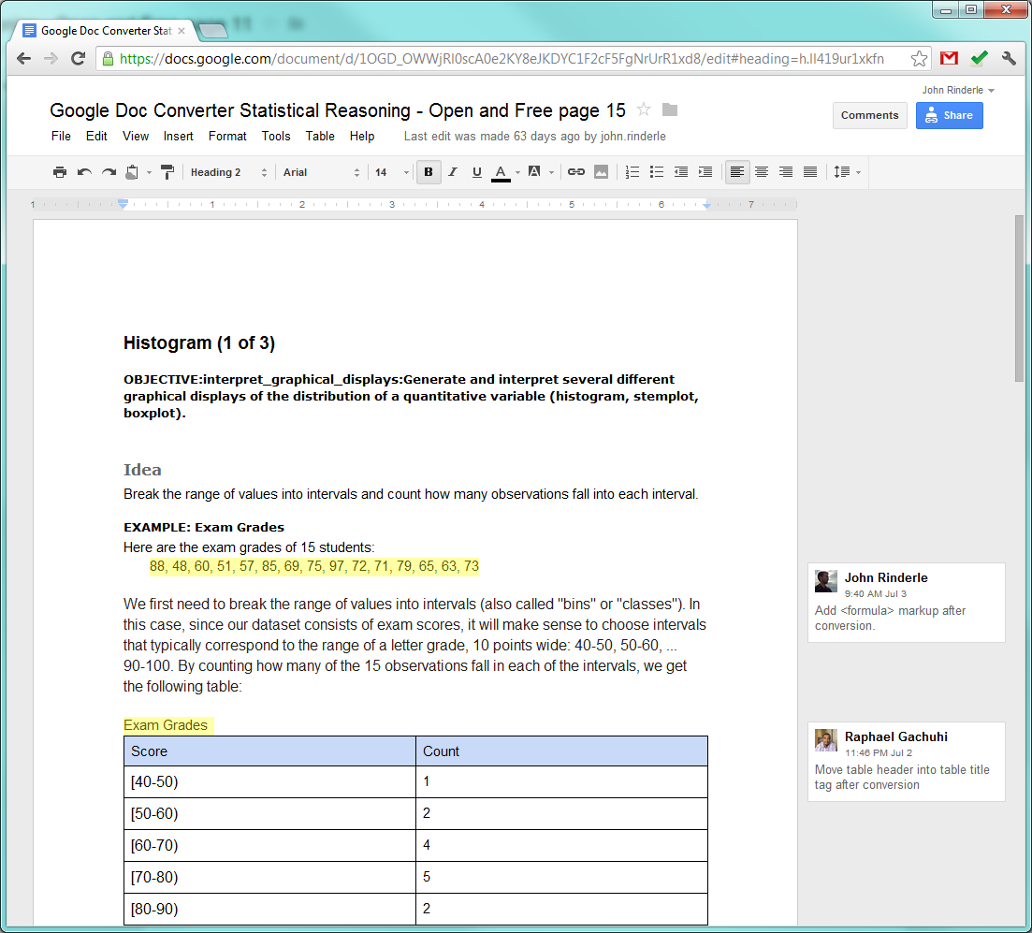
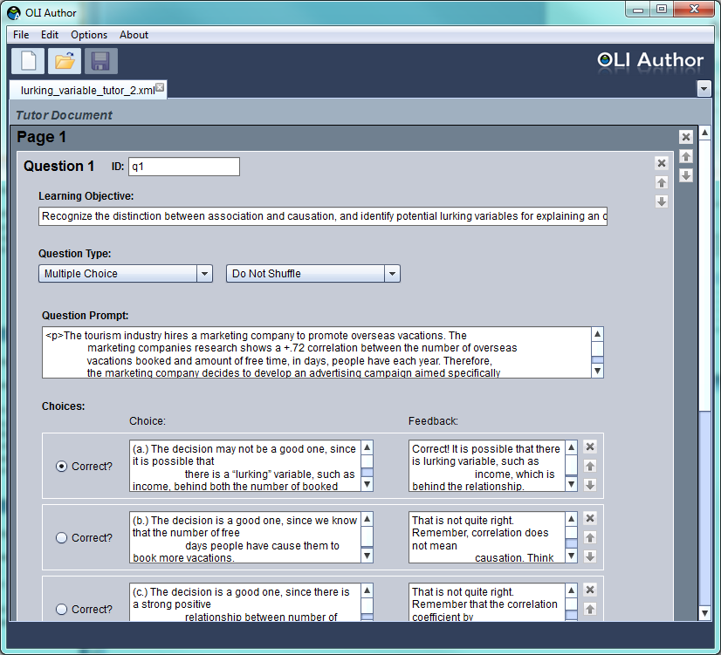
Platform+: Authoring Tools

Slide 8
Using Google Docs with OLI
Demo

Slide 9
Using Google Docs with OLI
Standard Types of Content
Text
Bold
Italics
Highlight
Subscript
Superscript
Image
Table
List
Hyperlinks
Comments
Additional Content Using Headings
Sub-heading / page section
Definition
Example
Block Quote
Learning Activity
YouTube Video
Callout (e.g. Note, Tip, etc.)
Figure
Page Break

Slide 10
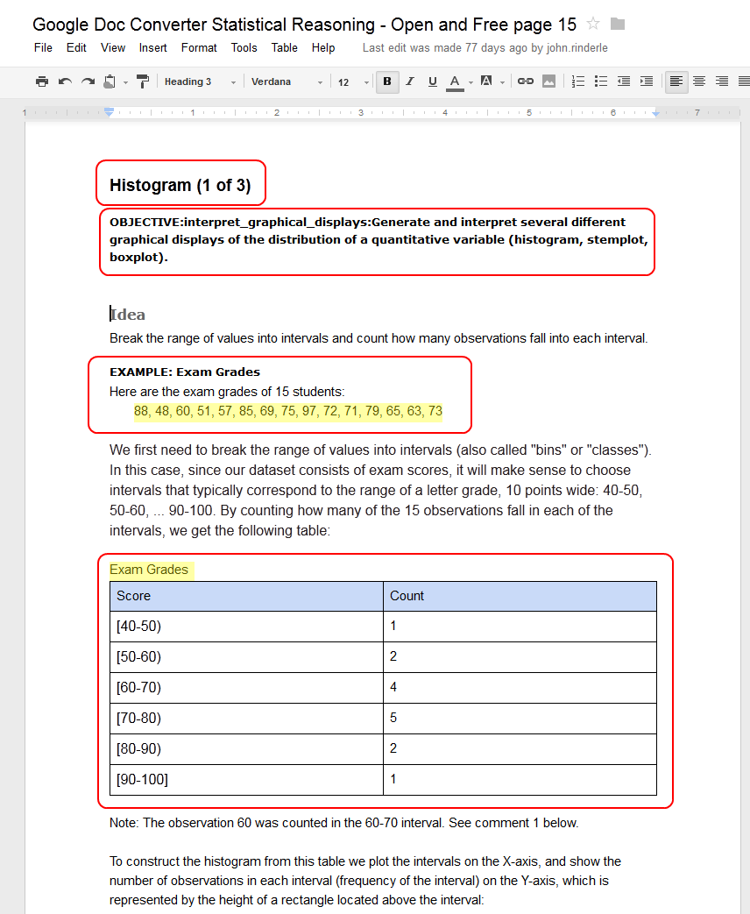
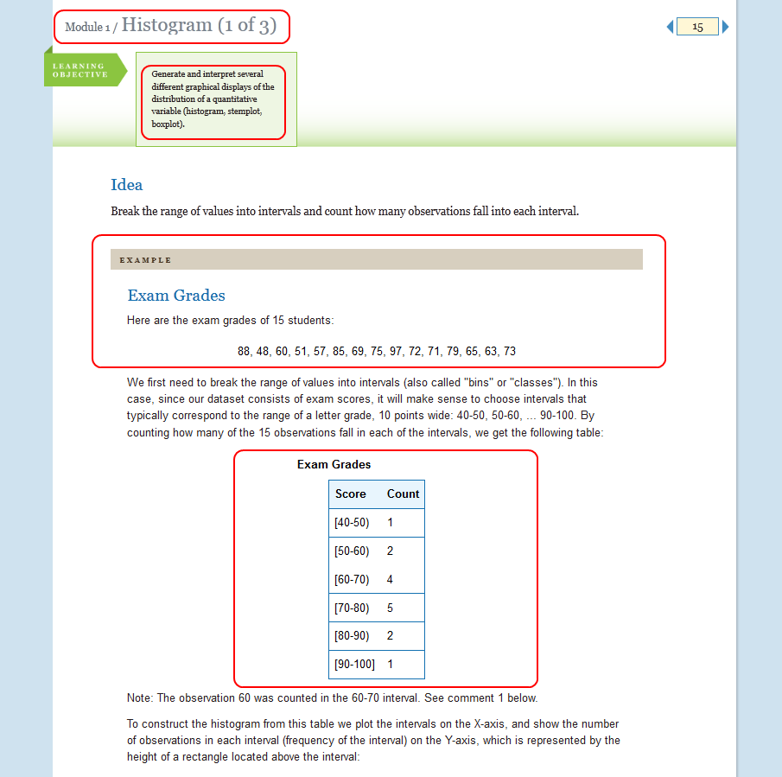
Using Google Docs with OLI

Slide 11
Using Google Docs with OLI

Slide 12
Creating Tutors with OLI Author
http://oli.cmu.edu/tools/oliauthor/

Slide 13
Creating Tutors with OLI Author
Types of Questions in OLI Author:
Multiple choice
Submit and compare
Text
Number
Additional Question Types Available in XML:
Fill in the blank
Image hotspot
Drag and drop

Slide 14
Types of Practice Activities
Learn By Doing – while presenting a concept, so that students can practice the concept as they learn it
Did I Get This – at the end of a chunk of content, so that the student can self-assess
Both target areas where students often have trouble, or where there are common misconceptions

Slide 15
Workshop Pre-Work
Prepare Content
1 or 2 Student centered measureable learning outcomes
2 to 3 Activities with hints/feedback to practice
2 to 3 Pages of text to explain and demonstrate
Test and configure your system

Slide 16
The Course Design Triangle
Objectives
Descriptions of what students should be able to do at the end of the course
Assessments
Tasks that provide feedback on students’ knowledge and skills
Instructional Activities
Contexts and activities that foster students’ active engagement in learning
Notes:
In many cases, problems in a course arise when there is a disconnect between these two.

Slide 17
Test and Configure Your System
SSH Client
Subversion Client
Oxygen XML Editor
Adobe Flash Plugin
Adobe Air Plugin
Java Plugin
Formulator MathML Editor

Slide 18
Technical skills required
Create and edit XML documents
Manage files in a version control system
Operate UNIX command line tools
Create media files for the web
Troubleshoot common problems for the web

Slide 19
Technical skills required
XML
Create new and modify existing XML documents.
Use an XML editor to validate a document.
Identify and correct syntax errors which prevent a document from validating.
Use an XML editor to identify which elements and attributes are relevant in a given.

Slide 20
Technical skills required
UNIX
Connect to a remote system using an SSH client.
Navigate to a given directory (cd).
List the contents of a directory (ls).
Copy (cp) and move (mv) files.
Work with relative and absolute paths.
Follow step by step instructions, to run a series commands that perform a task.
Run existing command line tools and scripts.
No programming or shell scripting skills required.

Slide 21
Technical skills required
Version Control
Previous experience with version control preferred but not required (e.g. CVS, Subversion, Git, etc.)
Checkout a local copy of the files from the repository to your computer.
Add, delete, modify files to and from the repository.
"Commit" changes from your computer to the repository.

Slide 22
Technical skills required
Web Development
Create and resize images for the web.
Familiarity with common image, audio, and video formats.
Mastery of basic web concepts: hyperlinks, URLs and file paths, etc.
Ability to organize and manage web assets
Establish and keep to a file naming convention

Slide 23
How to Prepare
Three webinars leading up to the workshop:
Tuesday, September 11 – 2:30pm ET
Platform Overview
Tuesday, September 18 – 2:30pm ET
Authoring Tools
Configuring Your Computer
Assignment of Pre-Work
Tuesday, September 25 – 2:30pm ET
Version Control with SVN

Slide 24
Questions?
Platform+ Workshop:
October 3,4 and 5
300 South Craig Street
Carnegie Mellon University
Pittsburgh, PA
Contact us at:
oli-platform@andrew.cmu.edu

Slide 25
“Improvement in Post Secondary Education will require converting teaching from a ‘solo sport’ to a community based research activity.”
—Herbert Simon

