Slide 1
OLI Platform+ Workshop
John Rinderle

Slide 2
Agenda
Welcome and Introductions
Overview of the OLI Platform
Benefits and Limitations
Goals for the workshop
Who to send
How to prepare

Slide 3
The Open Learning Initiative
Established in 2002 to produce and improve exemplars of scientifically-designed online courses that enact instruction and support instructors. Current goals:
Support better learning and instruction with high-quality, scientifically-based, classroom-tested online courses and materials.
Share our courses and materials openly and freely so that anyone can learn.
Develop a community of use, research, and development.

Slide 4
More than Technology – An Approach to Effective Instruction
An approach to designing, developing, delivering and improving learning experiences
Science
Technology
Teams
Data
Science of Learning
Evaluation
Improvement
Platform
In-course Affordances
Team-based Development
Communities of Research and Use
Capture
In-course Use
Iterative Improvement
Research

Slide 5
Learner Centered Design
Learning results from what the student does and thinks and only from what the student does and thinks. The teacher can advance learning only by influencing what the student does to learn.
Herbert Simon, 2001
It’s not teaching that causes learning. Attempts by the learner to perform cause learning, dependent upon the quality of feedback and opportunities to use it.
Grant Wiggins
President, Center of Learning Assessment

Slide 6
The Course Design Triangle
Objectives
Descriptions of what students should be able to do at the end of the course
Assessments
Tasks that provide feedback on students’ knowledge and skills
Instructional Activities
Contexts and activities that foster students’ active engagement in learning
Notes:
In many cases, problems in a course arise when there is a disconnect between these two.

Slide 7
Why a “learner-centered” approach?
An essential part of facilitating learning is understanding the learner.
Influences her
A learner’s
Interpretation of information
Retrieval of knowledge
Organization of new information
Synthesis and application of new knowledge
Expectations
Adjustment to new situations
Prior knowledge/life experience
Goals
Values, attitudes, beliefs

Slide 8
What do you want your students to be able to do by the end of the module?
Prior
Knowledge
Learning
Knowledge
after course
Performances & demonstrations of knowledge
Performances & demonstrations of knowledge
Eberly Center for Teaching Excellence
Carnegie Mellon

Slide 9
Different Kinds of Objectives
Bloom’s Taxonomy identifies six levels of cognitive processes.
Across these levels, knowledge is used in more sophisticated ways:
Recall: remember, recognize, identify
Understand: interpret, exemplify, classify, summarize, explain, compare
Apply: execute, implement, use, carry out
Analyze: differentiate, distinguish, organize, select
Evaluate: check, critique, judge, monitor, test
Create: generate, plan, produce, construct, hypothesize

Slide 10
Why Use Learning Activities?
They give students an opportunity to interact with the course and get timely, targeted feedback as they work
One of the key benefits of online education!
They give instructors feedback on what concepts students are struggling with as they work through the course
One of the key benefits of online education!
They drive the Instructor Dashboard (and soon the Student Dashboard)
Must be tied to Learning Objectives

Slide 11
Where do Learning Activities fit into a course?
Learn By Doing – while presenting a concept, so that students can practice the concept as they learn it
Did I Get This - at the end of a chunk of content, so that the student can self-assess
Areas where students often have trouble, or where there are common misconceptions

Slide 12
Types of Instructional Activities
Declarative Content
Worked Examples and Partially Worked Examples
Learn By Doing
Did I Get This
Lab (StatTutor)
Many Students Wonder
My Response
Simulation (demonstrate and allow students to explore)
Walkthrough (multimedia explanation)
(This is NOT an exhaustive list)

Slide 13
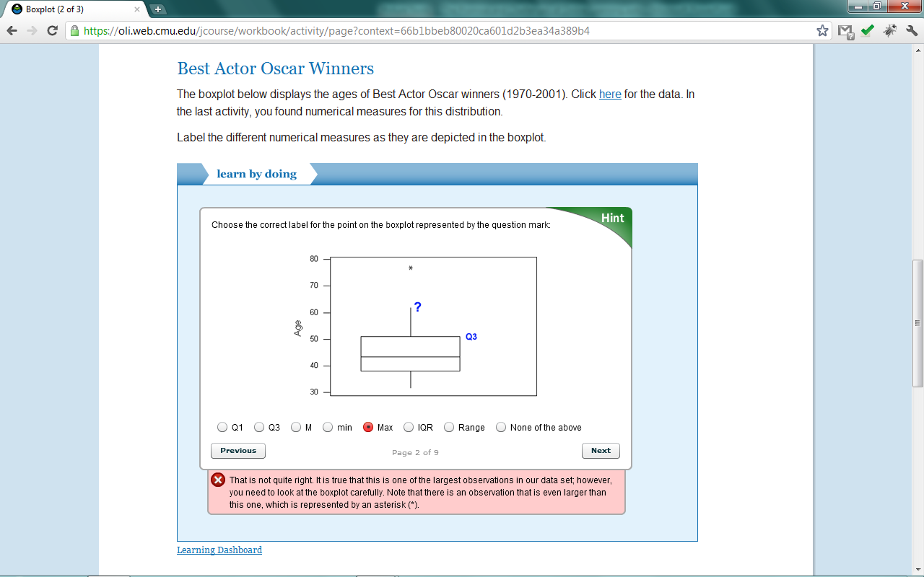
Demonstration
Notes:
Demonstrate the student, instructor, developer experiences.
OLI courses include:
Student centered, measureable learning objectives
Explanation
Worked examples, simulations, demonstrations
Learn by doing: frequent opportunities for guided practice, provides immediate feedback, hints and feedback target specific errors and student misconceptions, safe place to learn, students encouraged to keep working until the correct response is reached
Did I get this: self-check, encourage students to self evaluate and decide if they “got it”, continue to provide immediate contextual feedback, guide students to extra practice if needed
System collects data on student interactions to enable feedback to the learner, the instructor, and the course designer

Slide 14
OLI Supported Development
Best Practices (all projects): Apply learning science research and scientific method to OER development, implementation and evaluation.
Platform+ (25 projects): Use rich data gathered from student interactions to drive multiple feedback loops for continuous improvement.
Co-development (3 teams): Develop OER collaboratively: Teams of TAACCCT grantees with OLI learning scientists, human computer interaction experts & software engineers.
Notes:
OLI will offer three tiers of support to grantees:
Information and support on effective course design and evaluation.
Course delivery and data capture for 25 grantees via out Platform+ program.
Three teams of grantees will be selected to participate with OLI in full Co-development efforts.

Slide 15
Platform+: What are the benefits?
Free training, project space, and hosting.
Satisfy TAACCCT grant requirements.
Design activities for practice and feedback.
Attend to student variability through UDL.
Capture data on student learning and behavior.
Notes:
Platform+ is best suited for new course development projects wishing to take a learner centered approach, aligning outcomes to practice, capturing data, and using that data to evaluate effectiveness.

Slide 16
Platform+: What are the benefits?
Free training, project space, and hosting.
Opportunities to share and interact
Technical training and support
Access to platform and authoring tools
Project space for development
Course hosting
Access to learning data and reports

Slide 17
Platform+: What are the benefits?
Satisfy TAACCCT grant requirements.
Creative Commons licensing
LRMI metadata (coming soon)
Accessibility compliance
Targeting WCAG and Section 508
Interoperability with LMS systems
Using the LTI standard

Slide 18
Platform+: What are the benefits?
Design activities for practice and feedback.
State desired learning outcomes.
Use advanced assessment tools to create interactive practice activities.
Add hints and feedback to target student misconceptions and offer immediate feedback.
Access instructor feedback reports for a real-time view of student performance.

Slide 19
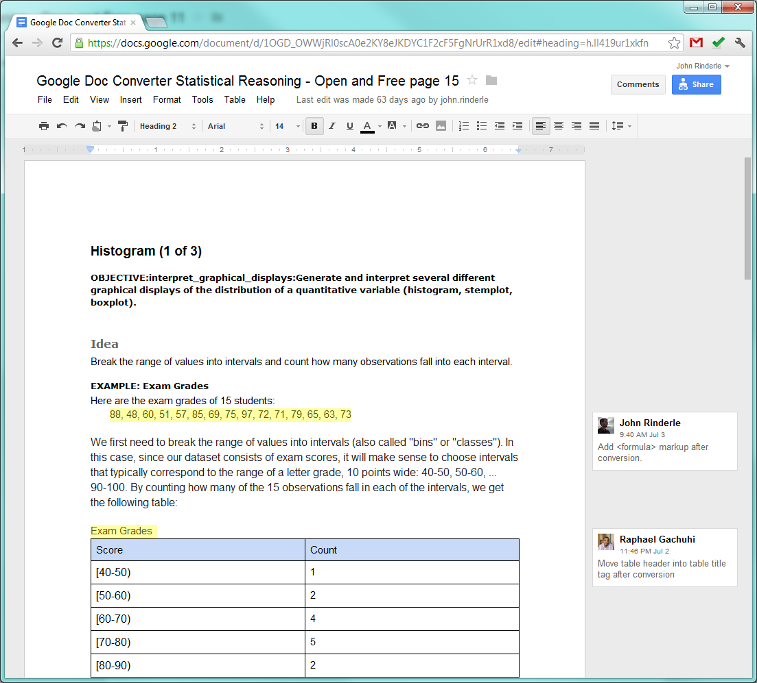
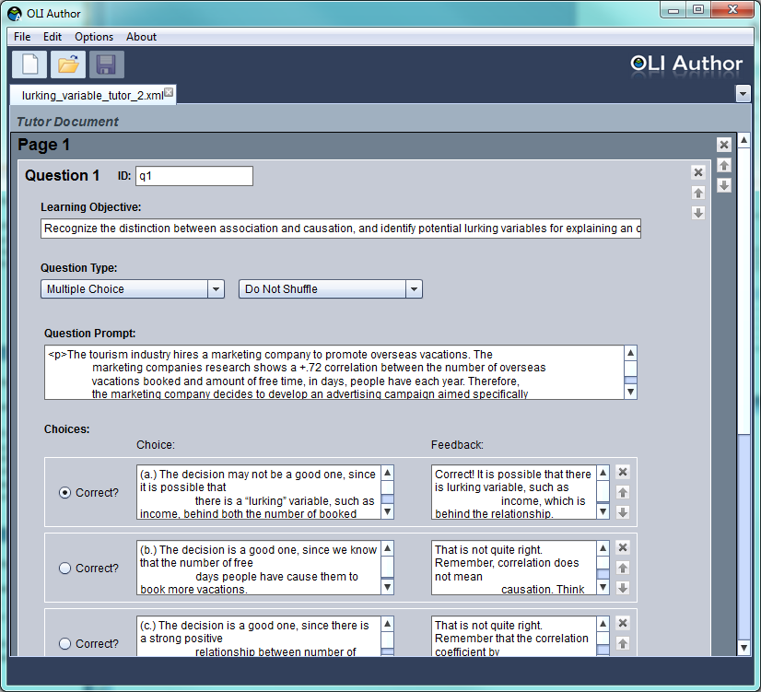
Platform+: Authoring Tools

Slide 20
Platform+: What are the benefits?
Attend to student variability through UDL.
Universal Design for Learning enhancements increase flexibility and allow learners multiple ways to recognize, act on, and engage with knowledge.
Notes:
Provide learners with choice. Apply a variety of enhancement options including multimedia glossaries to support technical vocabulary development, notepads and tagging systems, text-to-speech tools, audio recording features, drawing features, and electronic coaches that can be scripted to provide hints, models, and think-alouds.

Slide 21
Platform+: What are the benefits?
Capture data on student learning and behavior.
Track student actions through a course.
Identify areas where students succeed and struggle. Use data reports to focus efforts to refine materials for future students.
Measure effectiveness. Use data to evaluate the impact of the resources you create.
Notes:
The OLI platform tracks student actions through a course, including: respond to a question, receive feedback, ask for a hint, login, view a page, etc. Projects will receive access to summary reports and raw data.
Continuously improve. Identify areas where students succeed and struggle. Use data reports to focus your efforts to refine materials for future students.
Measure effectiveness. Take a scientific approach to course design. Use data to evaluate the impact of the resources you create.
Contribute to a virtuous cycle. Data improves our understanding of human learning which in turn allows us to build more effective instructional tools and practice. Join OLI and CAST in this community based research activity.

Slide 22
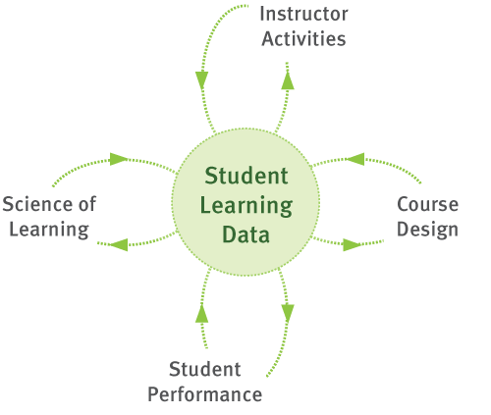
Data drives powerful Feedback Loops

Slide 23
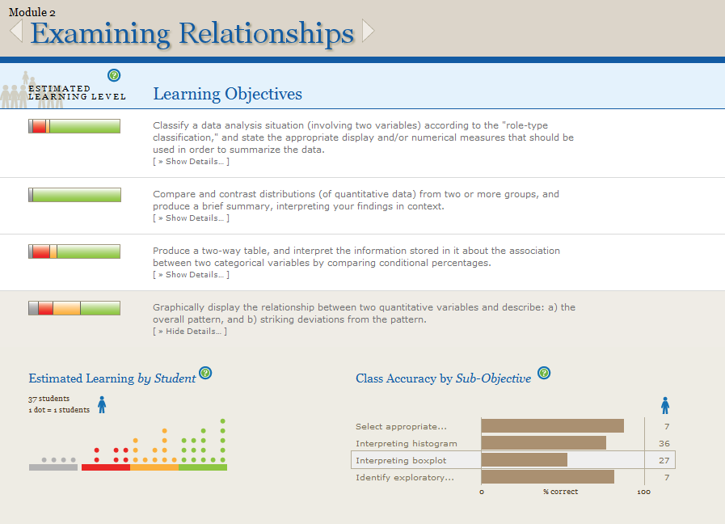
Instructor Learning Dashboard
Notes:
The instructor Learning Dashboard provides instructors with a real-time, outcomes centered view of student progress.
In a blended mode course, students complete an OLI module as homework. As they are working the system collects data about their learning. Instructors access the Learning Dashboard before class. With a few clicks, the Learning Dashboard allows instructors to see where students are succeeding and where they need support. For each learning outcome in the module, the Learning Dashboard offers an estimate level of learning for each student. Grey = students are not practicing, Red = students either need more practice or having difficulty, Orange = students are on their way, and Green = we predict students are able to demonstrate the learning outcome successfully.

Slide 24
Let’s acknowledge the tradeoffs
Requires a measured design, built around observable learning outcomes
Not a learning management system or content repository for distributing existing resources.
Hosted solution, students access resources from a shared website.
Notes:
Platform+ is not a learning management system or content repository for distributing existing resources.
It is a hosted solution where students access resources from a shared website.
While content is exportable to XML the platform does not produce a content package which can be directly imported into other systems. Instead, Platform+ integrates with your existing learning management system using the Basic LTI standard.
Platform+ does not offer live editing. While you can update live content to fix errors, it isn’t possible to make large changes on the fly. This is to provide a consistent student experience to capture evaluation data and provide a stable learning environment.

Slide 25
Let’s acknowledge the tradeoffs
Content not directly importable to other systems as a content package.
Not a “live edit”, WYSIWYG environment
Emphasis on stability for “live” courses, not a just-in-time authoring environment
Notes:
Platform+ is not a learning management system or content repository for distributing existing resources.
It is a hosted solution where students access resources from a shared website.
While content is exportable to XML the platform does not produce a content package which can be directly imported into other systems. Instead, Platform+ integrates with your existing learning management system using the Basic LTI standard.
Platform+ does not offer live editing. While you can update live content to fix errors, it isn’t possible to make large changes on the fly. This is to provide a consistent student experience to capture evaluation data and provide a stable learning environment.

Slide 26
By the end of the workshop…
You will have created your first OLI module
Design learner centered content with UDL affordances
Design activities for data collection and feedback
Create and publish content to the OLI platform
Know where and how to get support
Implement a workflow and project plan to support your work

Slide 27
Who do I send?
Technical implementer role
Instructional design role
Faculty content expert role
Success at and after the workshop requires:
A project under active development
Sample content ready for the workshop
Ability to perform the technical tasks
Project team with time and institutional support to continue

Slide 28
Technical skills required
Create and edit XML documents
Manage files in a version control system
Operate UNIX command line tools
Create media files for the web
Troubleshoot common problems for the web

Slide 29
Technical skills required
XML
Create new and modify existing XML documents.
Use an XML editor to validate a document.
Identify and correct syntax errors which prevent a document from validating.
Use an XML editor to identify which elements and attributes are relevant in a given.

Slide 30
Technical skills required
UNIX
Connect to a remote system using an SSH client.
Navigate to a given directory (cd).
List the contents of a directory (ls).
Copy (cp) and move (mv) files.
Work with relative and absolute paths.
Follow step by step instructions, to run a series commands that perform a task.
Run existing command line tools and scripts.
No programming or shell scripting skills required.

Slide 31
Technical skills required
Version Control
Previous experience with version control preferred but not required (e.g. CVS, Subversion, Git, etc.)
Checkout a local copy of the files from the repository to your computer.
Add, delete, modify files to and from the repository.
"Commit" changes from your computer to the repository.

Slide 32
Technical skills required
Web Development
Create and resize images for the web.
Familiarity with common image, audio, and video formats.
Mastery of basic web concepts: hyperlinks, URLs and file paths, etc.
Ability to organize and manage web assets
Establish and keep to a file naming convention

Slide 33
How to Prepare
Three webinars leading up to the workshop:
Tuesday, September 11 – 2:30pm ET
Platform Overview
Tuesday, September 18 – 2:30pm ET
Authoring Tools
Configuring Your Computer
Assignment of Pre-Work
Tuesday, September 25 – 2:30pm ET
Version Control with SVN

Slide 34
Workshop Pre-Work
Prepare Content
1 or 2 Student centered measureable learning outcomes
2 to 3 Activities with hints/feedback to practice the outcome
2 to 3 Pages of text in support of the outcome
Test and configure your system

Slide 35
“Improvement in Post Secondary Education will require converting teaching from a ‘solo sport’ to a community based research activity.”
—Herbert Simon

Slide 36
Questions?
Platform+ Workshop:
October 3,4 and 5
Carnegie Mellon University
Pittsburgh, PA
Contact us at:
oli-platform@andrew.cmu.edu

