Slide 1
Google Doc Converter
Raphael Gachuhi

Slide 2
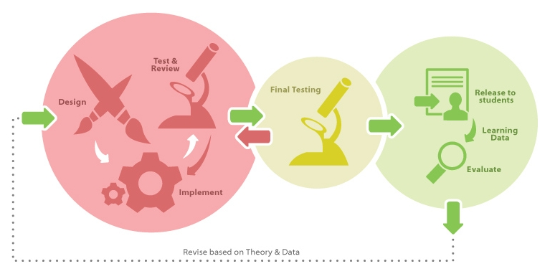
Big Picture

Slide 3
Objectives
By the end of this presentation, you will be able to:
Install OLI Google Docs converter on your computer
Explain what workbook pages are and how they are used in a course
Download your workbook pages from Google Docs
Convert the workbook pages downloaded from Google Docs(.odt files) to OLI XML(.xml)
Add workbook pages to the course project organization file
Add content not supported by Google Docs to the workbook page XML

Slide 4
Design

Slide 5
Design Phase
Design student centered measurable learning outcomes (Learning Objectives)

Slide 6
Design Phase
Design activities that support these student centered measurable learning outcomes
Types of activities to support Learning objectives
Workbook page (expository content, other activities etc)
Learn by doing
Did I get this?
My Response
Checkpoint, Quiz
etc

Slide 7
OLI Workbook page activities via Google Docs
Why use Google Docs
No/Little learning curve for team members
Collaborative environment
Rapid prototyping (due to teamwork)
Simple markup rules

Slide 8
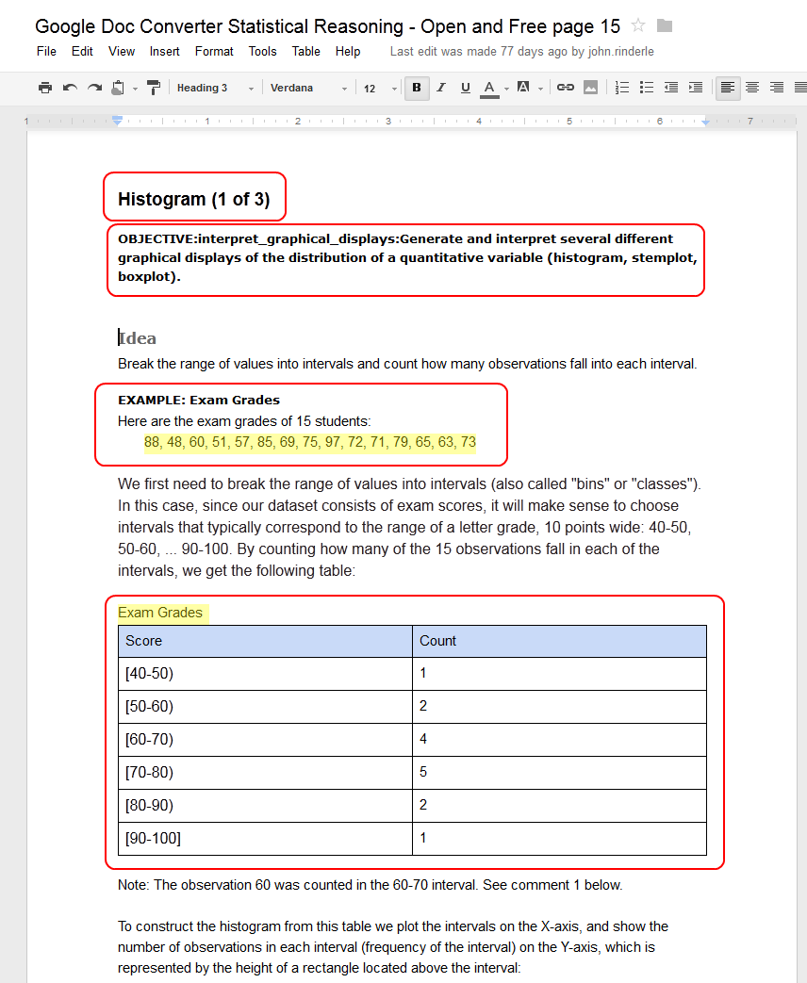
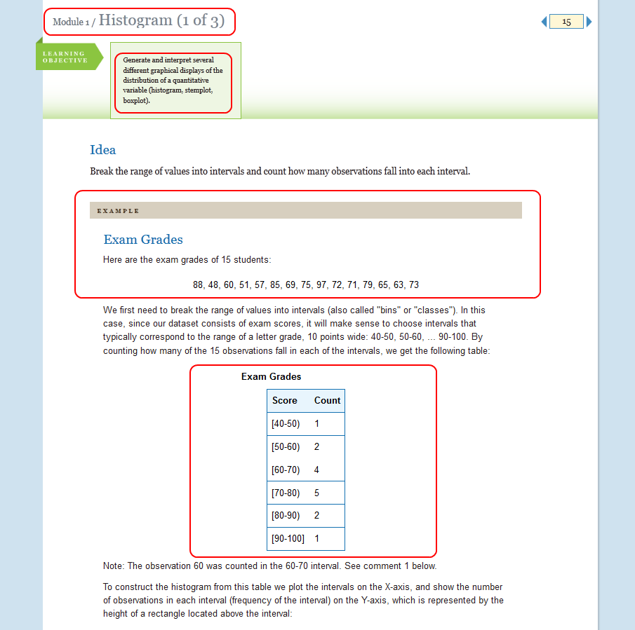
Using Google Docs with OLI

Slide 9
Using Google Docs with OLI
Standard Types of Content
Text
Bold
Italics
Highlight
Subscript
Superscript
Image
Table
List
Hyperlinks
Comments
Additional Content Using Headings
Sub-heading / page section
Definition
Example
Block Quote
Learning Activity
YouTube Video
Callout (e.g. Note, Tip, etc.)
Figure
Page Break

Slide 10
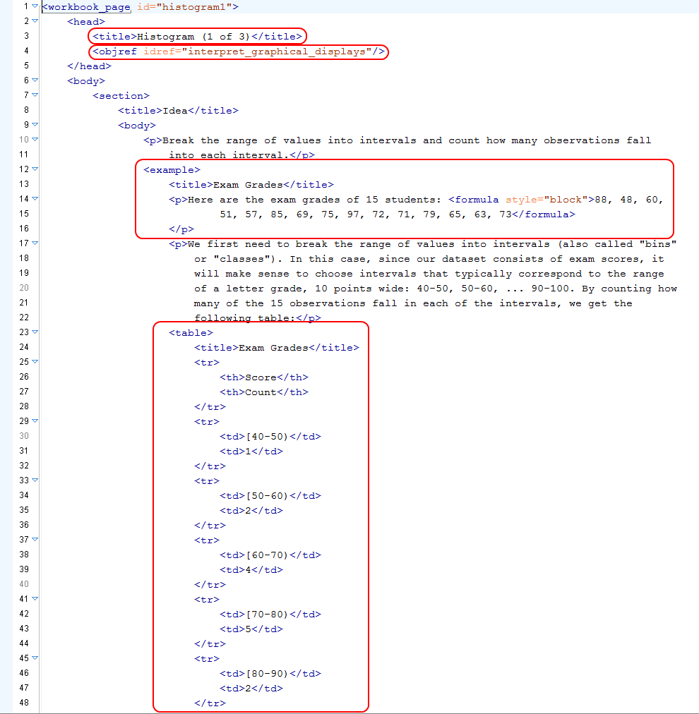
Using Google Docs with OLI

Slide 11
Google Doc Markup Guidelines
Location
https://docs.google.com/document/d/1R5fPNi3H4Tdhj3ehGD6ttD9GeeLpPCngGem1fT04sWM/edit
Example documents
https://docs.google.com/document/d/1OGD_OWWjRl0scA0e2KY8eJKDYC1F2cF5FgNrUrR1xd8/edit

Slide 12
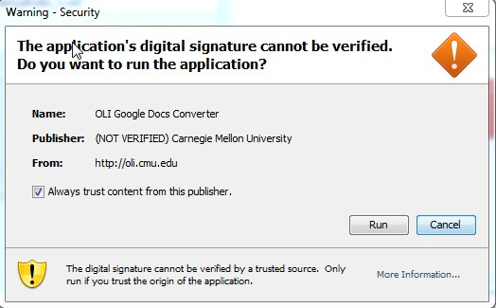
Installing the Converter
Download location
http://oli.cmu.edu/tools/oliconverter/
Things to consider during Installation
File extension for the installation file is .jnlp
Where your browser downloads the installation file
How to launch the installation file for your OS
Ignore the security warning and choose “always trust content from this publisher”

Slide 13
Installing the Converter
Java runtime is required:
For PC: Download from http://www.java.com
For Mac: download the version of Java that corresponds to your Mac’s operating system:
10.5 (Leopard): http://support.apple.com/kb/DL848
10.6 (Snow Leopard): http://support.apple.com/kb/DL1550
10.7 (Lion): http://support.apple.com/kb/DL1515

Slide 14
Implementation

Slide 15
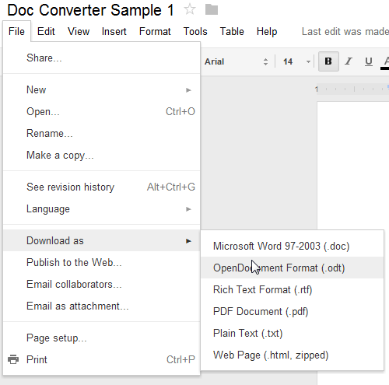
Download from Google Docs
Select File menu item
Open Download as menu list
Choose OpenDocument Format (.odt)
Download location depends on Browser used
Rename files to suit your naming convention

Slide 16
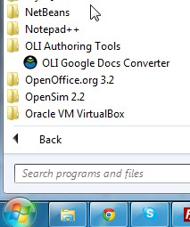
Launching the converter
On windows go to start>all programs>OLI Authoring Tools>OLI Google Docs Converter
On Mac navigate to the application folder using finder>double click on the OLI Google Docs Converter icon

Slide 17
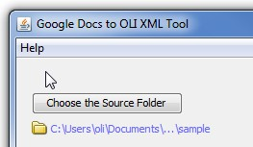
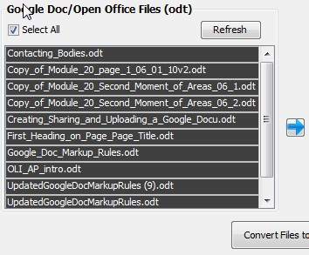
Convert the Google Doc (.odt) files
Choosing the files to convert
Dealing with Tutors (Inline assessments)
Comment out inline assessments until they are added to your project to avoid errors
Selecting a destination folder
To main project content folder
Performing the conversion
Examining the output

Slide 18
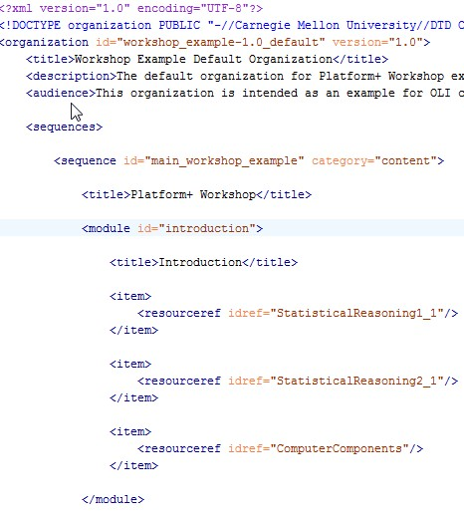
Content availability in the course
Add content to the organization xml file
Use the Workbook id to reference it within the item tag in the organization file
Workbook id is the filename without .xml (first part of the filename)

Slide 19
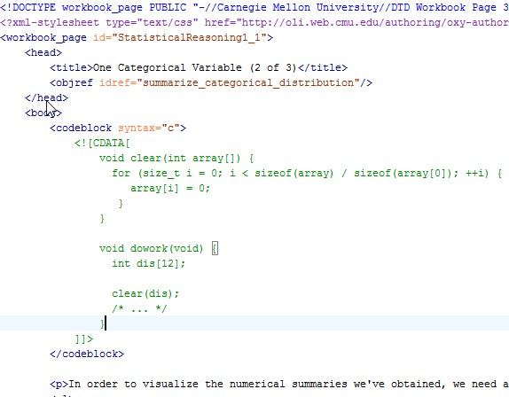
Google Doc unsupported content
Viewing and editing the output with Oxygen xml editor
Adding content not supported by Google Doc (e.g. formulas, codeblock, flash etc)

Slide 20
Learn by Doing: Convert Google Docs
Practice the procedures we have discussed:
Ensure Google Docs conform to markup guidelines
Download Google Docs
Install Converter
Convert Docs to OLI Workbook page XML
Add Workbook page to organization.xml
Edit XML output
Add new files to SVN and commit
Available as a Google Doc:
Learn by Doing: Convert Google Docs
The tutorial takes 20 to 30 minutes to complete.

