Slide 1


DataShop: An Educational Data Mining Platform for the Learning Science Community
John Stamper
Pittsburgh Science of Learning Center
Human-Computer Interaction Institute
Carnegie Mellon University
Presented at OLI Workshop 8/4/2012
Notes:
Why is data important to improving student learning
If we knew everything about students’ learning challenges, we would not need data
But, there is a lot we do not know ….

Slide 2
Pittsburgh Science of Learning Center (PSLC)
Why? Chasm between science & practice
  Low success rate (<10%) of randomized field trials
LearnLab = a socio-technical bridge between lab psychology & schools
  E-science of learning & education
  Social processes for research-practice engagement
Purpose: Leverage cognitive theory and computational modeling to identify the conditions that cause robust student learning
Notes:
The vision for the PSLC starts with the broad goals of understanding human learning and using that understanding to improve education. More specifically, we are working to fill the chasm that currently exists between learning science research and educational practice. A key indicator is the low hit rate of costly large-scale randomized control trials . It appears the science behind many of these trials may not have been sound and reliable enough (we believe in RFTs, but we need more science to build up to them).
2) Toward this end, we have created LearnLab …
Goals are to: Do rigorous science at scale. Create a two-way street. Have problems from practioners guide psychological research goals.
3) In general, our purpose is to “leverage cognitive … learning”.

Slide 3
DataShop
Central Repository
  Secure place to store & access research data
  Supports various kinds of research
    Primary analysis of study data
    Exploratory analysis of course data
    Secondary analysis of any data set
Analysis & Reporting Tools
  Focus on student-tutor interaction data
  Data Export
    Tab delimited tables you can open with your favorite spreadsheet program or statistical package
    Web services for direct access
3
Notes:
3
So, what exactly is DataShop?
Well, first it is a central repository for all of the data generated by PSLC studies and courses. The goal is to eventually have all of the data from learnlab studies and courses safely tucked away in DataShop for safe keeping.
Once data is in, users can conduct primary, secondary and exploratory analysis of datasets.
Second, DataShop provides analysis and reporting tools. It’s a place where researchers can jumpstart analyses – perhaps by drilling down on student performance data through the Performance Profiler or viewing learning trends through the Learning Curve tool.
You can also get data out through various export options.

Slide 4
Repository
Allows for full data management
Controlled access for collaboration
File attachments
Paper attachments
Great for secondary analyses
How much data does DataShop have?

Slide 5
How big is DataShop?
Domain | Files | Papers | Datasets | Student Actions | Students | Student Hours
Language | 64 | 11 | 77 | 6,185,541 | 6,420 | 6,821.84
Math | 211 | 49 | 166 | 68,151,335 | 30,317 | 143,154.81
Science | 91 | 19 | 86 | 11,293,010 | 14,192 | 38,911.03
Other | 18 | 12 | 40 | 5,558,983 | 9,697 | 20,015.38
Total | 384 | 91 | 369 | 91,188,869 | 60,626 | 208,903.06
As of October 2012

Slide 6
What kinds of data?
By domain based on studies from the Learn Labs
Data from intelligent tutors
Data from online instruction
Data from games
The data is fine grained at a transaction level!

Slide 7
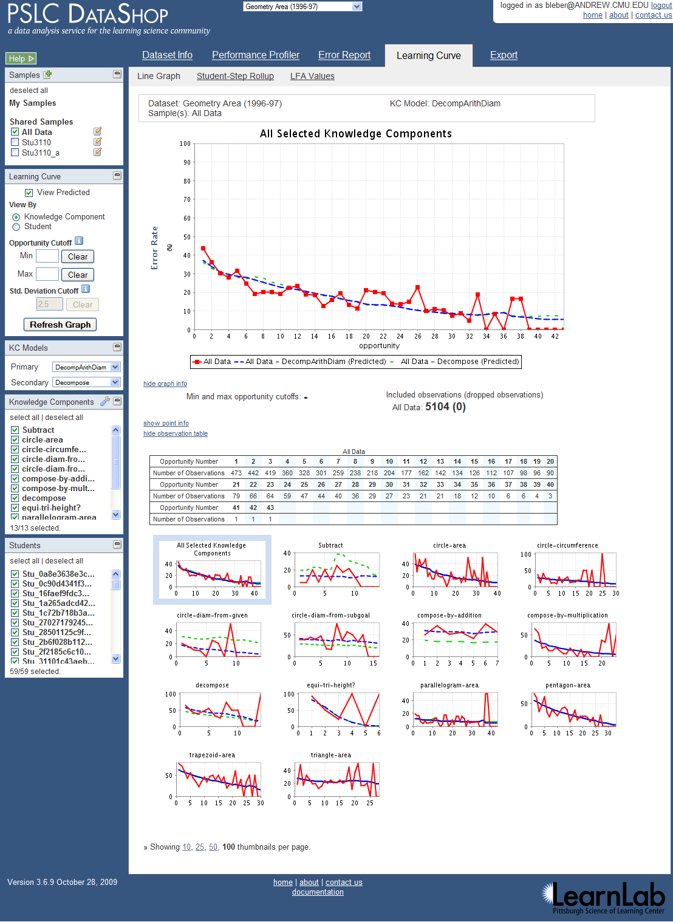
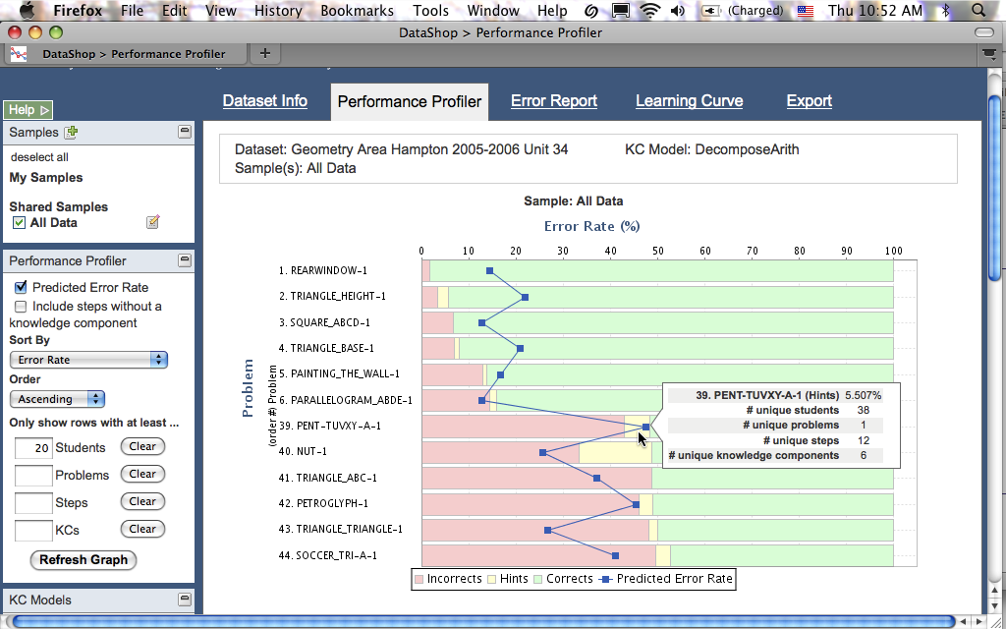
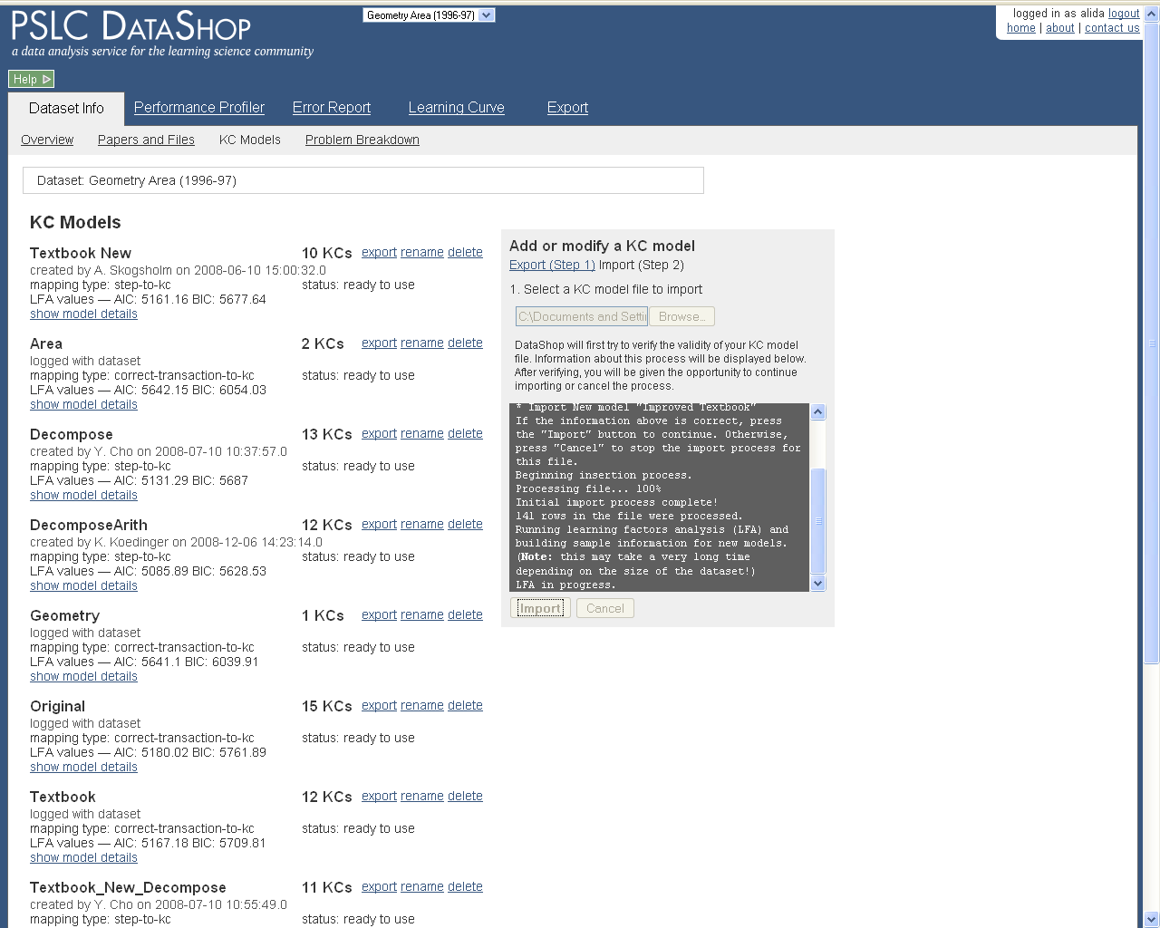
Web Application

Slide 8
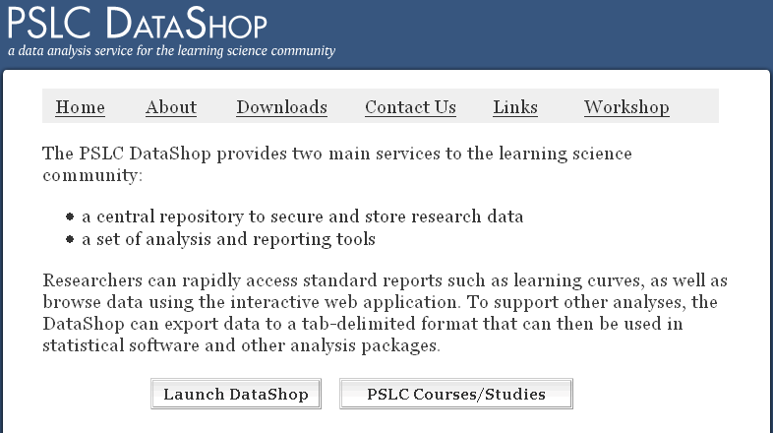
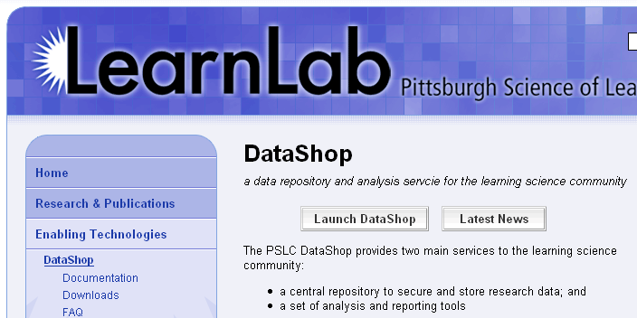
Getting to DataShop
Explore data through the DataShop tools
Where is DataShop?
  http://pslcdatashop.org
  Linked from DataShop homepage and learnlab.org
    http://pslcdatashop.web.cmu.edu/about/
    http://learnlab.org/technologies/datashop/index.php
8
Notes:
8
OK, so your data is now in DS – what do you do with it now?
This is where the analysis tools come in handy.
To play around with the tools, you can log into DS. This slide shows you two ways of doing that – launching via our homepage or from the learnlab.org site.

Slide 9
Creating an account
On DataShop's home page, click
"Sign up now". Complete the form to create your DataShop account.
If you’re a CMU student/staff/faculty, click “Log in with WebISO” to create your account.
9

Slide 10
Getting access to datasets
By default, you will have access to the public datasets.
For access to other datasets, you can request access from dataset
10

Slide 11
DataShop Terminology
Problem: a task for a student to perform that typically involves multiple steps
Step: an observable part of the solution to a problem
Transaction: an interaction between the student and the tutoring system.

Slide 12
DataShop Terminology
Observation: a group of transactions for a particular student working on a particular step.
Attempt: transaction; an attempt toward a step
Opportunity: a chance for a student to demonstrate whether he or she has learned a given knowledge component. An opportunity exists each time a step is present with the associated knowledge component.
Notes:
If one transaction, it’s still an observation.

Slide 13
DataShop Terminology
KC: Knowledge component
  also known as a skill/concept/fact
  a piece of information that can be used to accomplish tasks
  tagged at the step level
KC Model:
  also known as a cognitive model or skill model
  a mapping between correct steps and knowledge components

Slide 14
Getting the KC Model Right!
The KC model drives instruction in adaptive learning
  Problem and topic sequence
  Instructional messages
  Tracking student knowledge

Slide 15
What makes a good Cognitive Model?
A correct expert model is one that is consistent with student behavior.
Predicts task difficulty
Predicts transfer between instruction and test
The model should fit the data!

Slide 16
Good Cognitive Model => Good Learning Curve
An empirical basis for determining when a cognitive model is good
Accurate predictions of student task performance & learning transfer
  Repeated practice on tasks involving the same skill should reduce the error rate on those tasks
  => A declining learning curve should emerge

Slide 17
How do we make KC Models?

Slide 18
Traditionally CTA has been used
  But Cognitive Task Analysis has some issues…
  Extremely human driven
  It is highly subjective
  Leading to differing results from different analysts
  And these human discovered models are usually wrong!

Slide 19
If Human centered CTA is not the answer
  How should student models be designed?
  They shouldn’t!
  Student models should be discovered not designed!

Slide 20
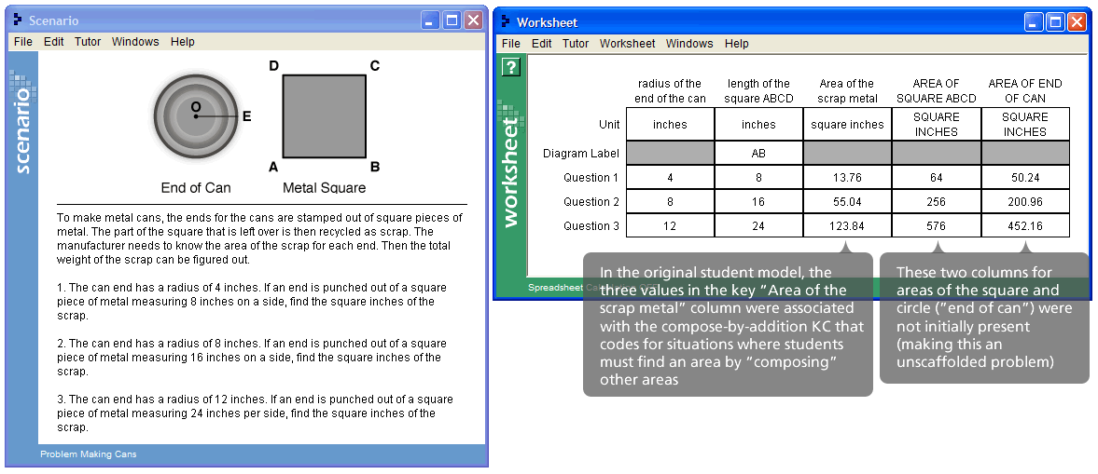
Solution – Use computers
  Today we have lots of log data from tutors
  We can harness this data to validate and improve existing student models

Slide 21
Human-Machine Student Model Discovery
  DataShop provides easy interface to add and modify student models and ranks the models using AFM

Slide 22
Human-Machine Student Model Discovery
  3 strategies for discovering improvements to the student model
  Smooth learning curves
  No apparent learning
  Problems with unexpected error rates

Slide 23
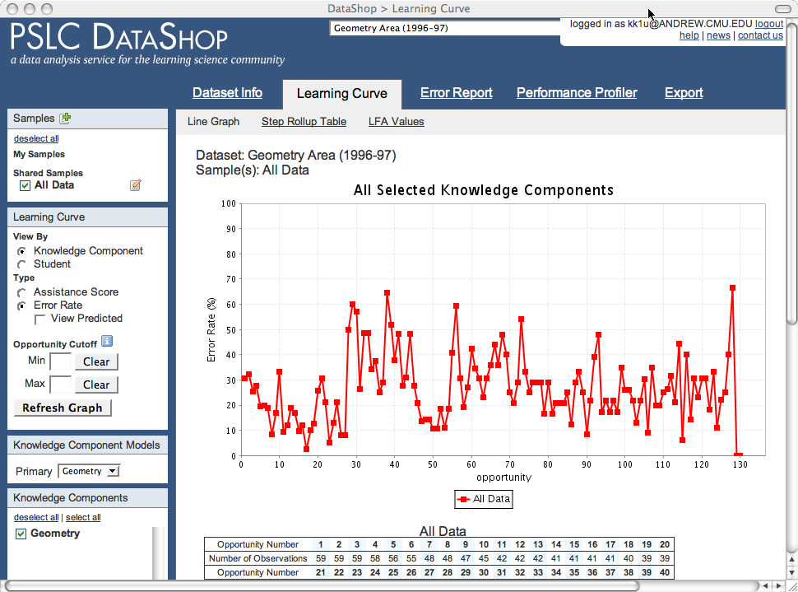
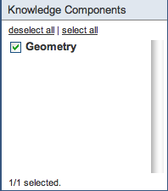
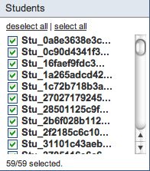
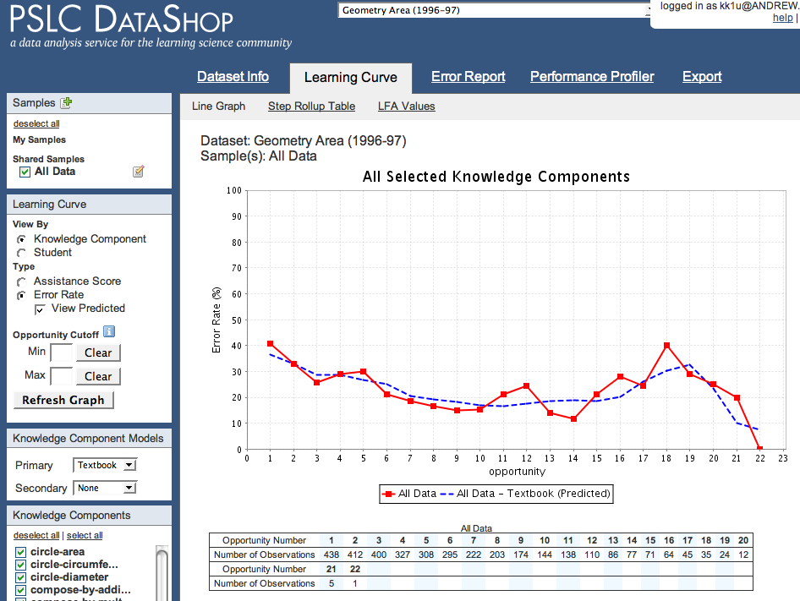
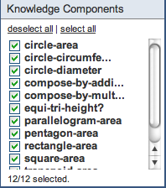
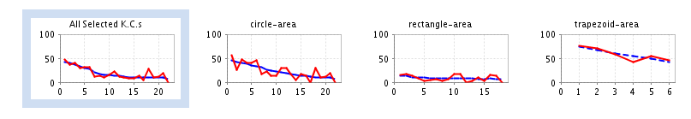
A good cognitive model produces a learning curve
Without decomposition, using just a single “Geometry” skill,
no smooth learning curve.
But with decomposition,
12 skills for area,
(Rise in error rate because poorer students get assigned more problems)
a smooth learning curve.
Is this the correct or “best” cognitive model?
Notes:
Good Cognitive Model => Good Learning Curve
An empirical basis for determining when a cognitive model is good
Accurate predictions of student task performance & learning transfer
Repeated practice on tasks involving the same skill should reduce the error rate on those tasks
=> A declining learning curve should emerge

Slide 24
Inspect curves for individual knowledge components (KCs)
Many curves show a reasonable decline
Some do not =>
Opportunity to improve model!

Slide 25
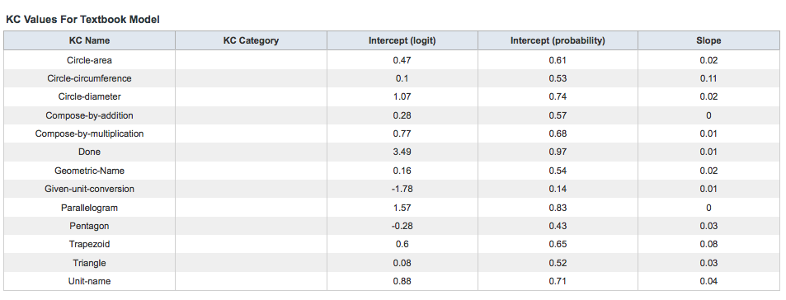
No apparent Learning

Slide 26
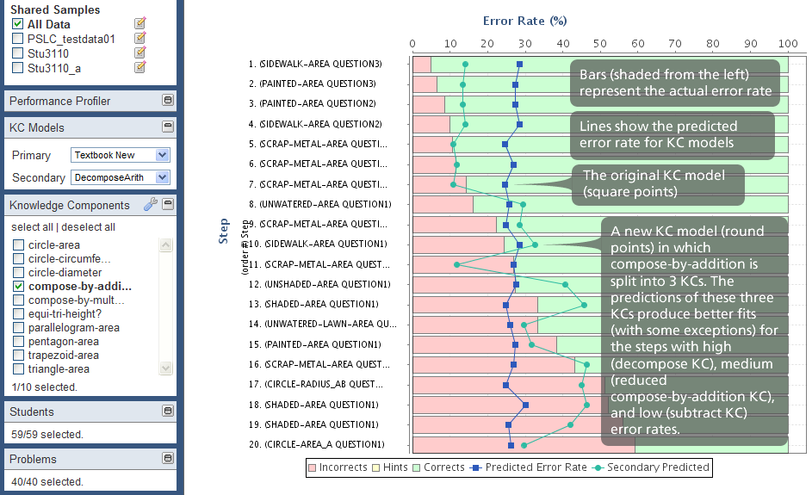
Problems with Unexpected Error Rates

Slide 27
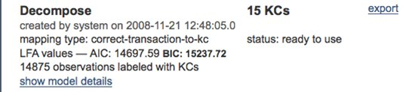
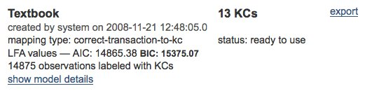
These strategies suggest an improvement
  Hypothesized there were additional skills involved in some of the compose by addition problems
  A new student model (better BIC value) suggests the splitting the skill.

Slide 28
Redesign based on Discovered Model
  Our discovery suggested changes needed to be made to the tutor
  Resequencing – put problems requiring fewer skills first
  Knowledge Tracing – adding new skills
  Creating new tasks – new problems
  Changing instructional messages, feedback or hints

Slide 29
Discovering cognitive models from data
Abstract from a computational symbolic cognitive model to a statistical cognitive model
For each task label the knowledge components that are required:
Original “Q matrix”
Other possible “learning factors”
Item | Skill | Add | Sub | Mul
2*8 | 0 | 0 | 1
2*8 – 3 | 0 | 1 | 1
2*8 - 30 | 0 | 1 | 1
3+2*8 | 1 | 0 | 1
Item | Skill | Deal with negative | Order of Ops | …
2*8 | 0 | 0
2*8 – 3 | 0 | 0
2*8 - 30 | 1 | 0
3+2*8 | 0 | 1

Slide 30
Can a data-driven process be automated & brought to scale?
Yes!
Combine Cognitive Science, Psychometrics, Machine Learning …
Collect a rich body of data
Develop new model discovery algorithms, visualizations, & on-line collaboration support

Slide 31
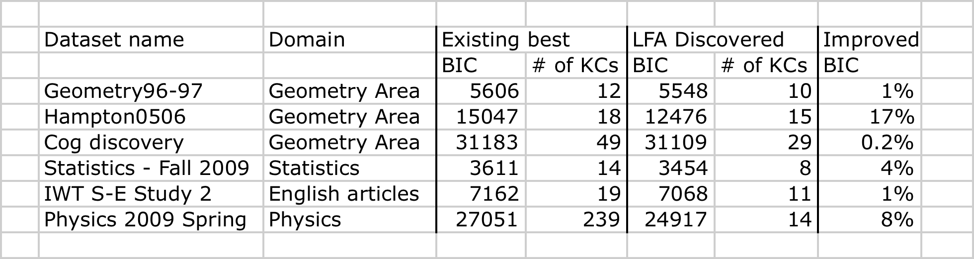
Discovery of new cognitive models: Strategy & Results
“Mixed initiative” human & machine discovery
  Visualizations to aid human discovery
  AI search for statistically better models
Better models discovered in Geometry, Statistics, English, Physics
Stamper, J., Koedinger, K.R. (2011) Human-machine Student Model Discovery and Improvement Using DataShop.
Notes:
These are recent (and preliminary) results and we are just beginning discussions with the domain-specialists (in Geometry, Statistics, English, Physics) about how to interpret discoveries for course redesign

Slide 32
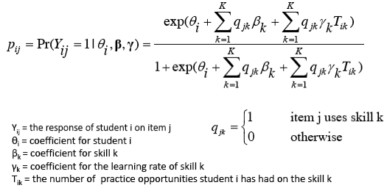
Logistic Regression Model of Student
Performance & Learning
“Additive Factor Model” (AFM) (cf., Draney, Pirolli, Wilson, 1995)
Evaluate with BIC, AIC, cross validation to reduce over-fit
Notes:
32

Slide 33
LFA –Model Search Process
Search algorithm guided by a heuristic: BIC
Start from an existing cog model (Q matrix)
Automates the process of hypothesizing alternative cognitive models & testing them against data
Notes:
33

Slide 34
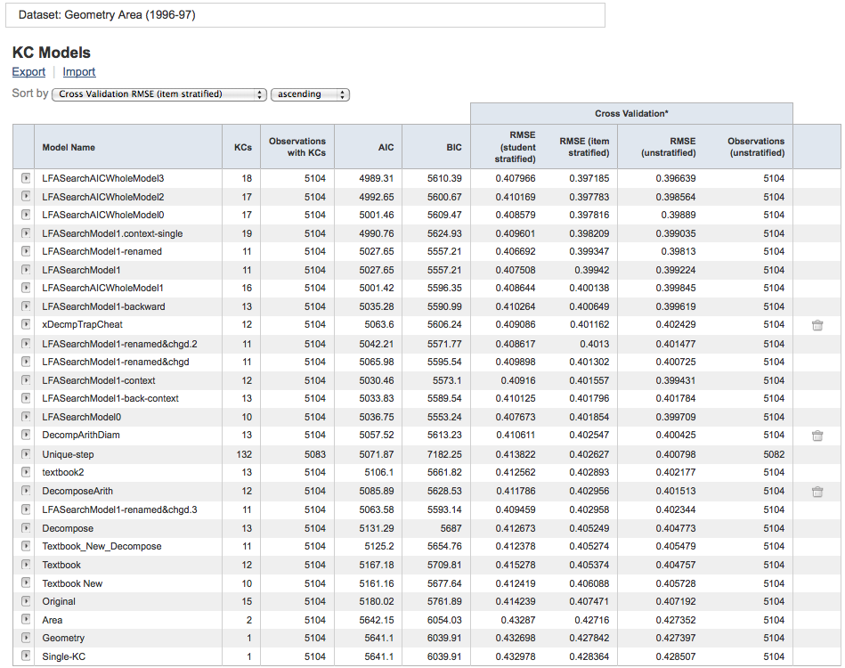
Cognitive Model Leaderboard for Geometry Area Data Set
Some models are machine generated (based on human-generated learning factors)
Some models are human generated

Slide 35
Summary
OLI data feeds into DataShop.
Optimal instructional design requires discoveries (The student is not like me)
Human Data-Driven methods can be used to discover better cognitive models

Slide 36
http://pslcdatashop.org
Questions?
john@stamper.org
datashop-help@lists.andrew.cmu.edu

