Slide 1
MathML for OLI courses
Hal Turner

Slide 2
Objectives
By the end of this session, participants should be able to:
Understand MathML and its purpose
Locate MathML’s use within the OLI Big Picture
Install and configure Formulator software on a Windows computer
Create a formula using Formulator’s WSYWIG interface
Enable MathML support in your workbook page
Insert Formulator’s output into XML of a course page

Slide 3
What is MathML?
MathML is a markup language that enables the high-quality display of mathematical formulas on web pages.
More accessible than image- or text-only displays
Used only for display of formulas in MathML, not for semantics or interactivity

Slide 4
MathML in The Big Picture
Implementation phase

Slide 5
Formulator Setup
Download and install Formulator http://sourceforge.net/projects/formulator-math/
Named “MathML Weaver” in folder Hermitech Laboratory > Formulator 4.0
Formulator is Windows-only, and thus cannot be installed on a Mac; for a Mac editor follow this link
http://mac.softpedia.com/get/Math-Scientific/MathML-wysiwyg-Editor.shtml

Slide 6
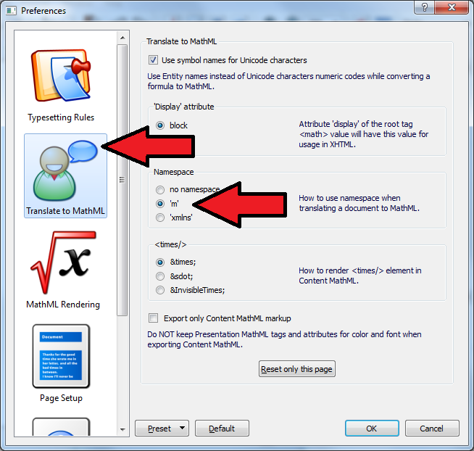
Formulator Setup, cont.
Update preferences to format output for use with OLI
Update namespace to format output for OLI use:
Edit (menu) > Preferences > Translate to MathML > Namespace ‘m’

Slide 7
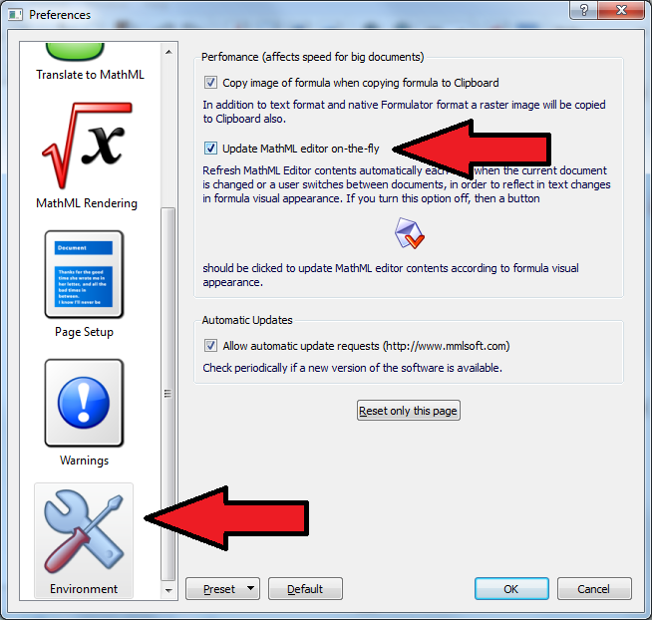
Formulator Setup, cont.
Update preferences to format output for use with OLI
Update Live Edit function so text edit box immediately reflects changes
Edit (menu) > Preferences > Environment > Update MathML editor on-the-fly

Slide 8
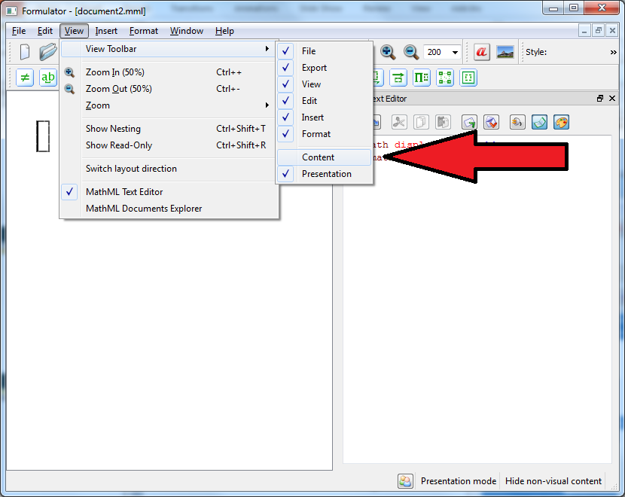
Formulator Setup, cont.
Update preferences to format output for use with OLI
OLI uses Formulator’s Presentation-mode output; hide the Content-mode toolbar:
View (menu) > View Toolbar > (uncheck) Content

Slide 9
Create formula using Formulator
Circumference of a circle:
$$C=2πr$$
Area of a circle:
$$A=πr^{2}$$

Slide 10
Create formula using Formulator, cont.
Use tiles to insert/edit a symbol or construction
For example, Greek letters tile expands and includes Pi

Slide 11
Create formula using Formulator, cont.
Use tiles to insert/edit a symbol or construction
For example, subscript/ superscript tile expands and includes various orientations

Slide 12
Create formula using Formulator, cont.
Highlight and copy the XML in the MathML Text Editor pane
This will be inserted in your page’s XML

Slide 13
Insert formula in course page XML
Ensure !DOCTYPE including MathML feature is used
XML will resemble example here

Slide 14
Resulting formulas in course page
Resulting page contains high-quality representation of formulas

Slide 15
Summary and Formulator Support
Install Formulator and edit Preferences
Create formula using WYSIWYG editor
Copy XML output and paste into course page’s code
Update course page’s DOCTYPE to enable MathML use
Formulator instructions, tutorials, and support on the developer’s website.

