Slide 1
Authoring for Effective Instruction
John Rinderle

Slide 2
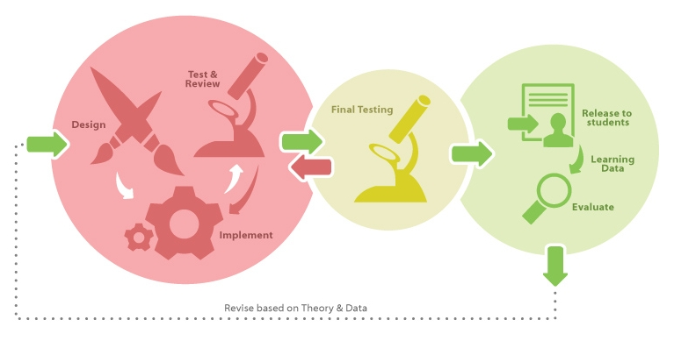
Big Picture: Design

Slide 3
Learning Objectives
By the end of this session, you will be able to…
Explain the importance of a learner centered approach and how to avoid the expert’s blind spot
Write student centered, measurable learning outcomes that enable data-driven improvement
Design hints and feedback which target common student misconceptions
Explain the different types of learning activities available in Platform+ and choose appropriately based on your goals
Discuss and implement learning design principles which promote effective instruction

Slide 4
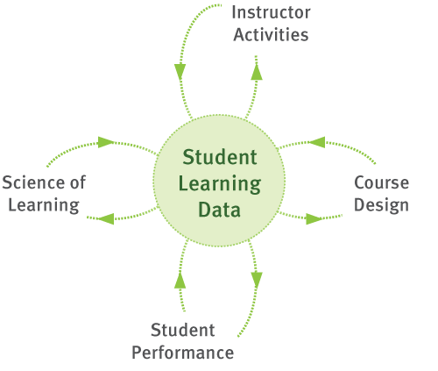
Data drives powerful Feedback Loops

Slide 5
Which problem type is most difficult for beginning algebra students?
Story Problem
As a waiter, Ted gets $6 per hour. One night he made $66 in tips and earned a total of $81.90. How many hours did Ted work?
Word Problem
Starting with some number, if I multiply it by 6 and then add 66, I get 81.90. What number did I start with?
Equation
x * 6 + 66 = 81.90

Slide 6
Algebra Student Results: Story Problems are Easier!

Slide 7
Algebra Student Results: Story Problems are Easier!
Nathan, M.J. & Koedinger, K.R. (2000). Teacher’s and researchers beliefs of early algebra development. Journal of Mathematics Education Research, 31(2), 168-190

Slide 8
Learner Centered Design
Learning results from what the student does and thinks and only from what the student does and thinks. The teacher can advance learning only by influencing what the student does to learn.
Herbert Simon, 2001
It’s not teaching that causes learning. Attempts by the learner to perform cause learning, dependent upon the quality of feedback and opportunities to use it.
Grant Wiggins
President, Center of Learning Assessment

Slide 9
Why a “learner-centered” approach?
An essential part of facilitating learning is understanding the learner.
Influences her
A learner’s
Interpretation of information
Retrieval of knowledge
Organization of new information
Synthesis and application of new knowledge
Expectations
Adjustment to new situations
Prior knowledge/life experience
Goals
Values, attitudes, beliefs

Slide 10
What do you want your students to be able to do by the end of the module?
Prior
Knowledge
Learning
Knowledge
after course
Performances & demonstrations of knowledge
Performances & demonstrations of knowledge
Eberly Center for Teaching Excellence
Carnegie Mellon

Slide 11
The Course Design Triangle
Objectives
Descriptions of what students should be able to do at the end of the course
Assessments
Tasks that provide feedback on students’ knowledge and skills
Instructional Activities
Contexts and activities that foster students’ active engagement in learning
Notes:
In many cases, problems in a course arise when there is a disconnect between these two.

Slide 12
The Triangle Exemplified
Learning Objective | … the students should be able to write a clear topic sentence
Instructional Activities | Categorize example sentences Revise poor examples Practice writing topic sentences
Assessment | Generate a clear topic sentence for a new topic

Slide 13
Why Focus on Learning Objectives?
They communicate our intentions clearly to students and to colleagues.
They provide a framework for selecting and organizing course content.
They guide in decisions about assessment and evaluation methods.
They provide a framework for selecting appropriate teaching and learning activities.
They give students information for directing their learning efforts and monitoring their own progress.
Based on A.H. Miller (1987), Course Design for University Lecturers. New York: Nichols Publishing.
Also see, C.I. Davidson & S. A. Ambrose (1994), The New Professor’s Handbook: A Guide to Teaching and Research in Engineering and Sciences. Bolton, MA: Anker Publishing Company Inc.

Slide 14
Different Kinds of Objectives
Bloom’s Taxonomy identifies six levels of cognitive processes.
Across these levels, knowledge is used in more sophisticated ways:
Recall: remember, recognize, identify
Understand: interpret, exemplify, classify, summarize, explain, compare
Apply: execute, implement, use, carry out
Analyze: differentiate, distinguish, organize, select
Evaluate: check, critique, judge, monitor, test
Create: generate, plan, produce, construct, hypothesize

Slide 15
Let’s Analyze Some Examples
Checklist: Is the objective…?
Student centered (i.e., student should be able to…)
Broken down into component skills (grain size)
Phrased with an action verb
Measurable
Here are some samples:
Understand the U.S. stock market
Logical flaws in a written argument
Appreciate the historical context of the 1940’s
Apply Newton’s Second Law appropriately

Slide 16
Where do Learning Activities fit into a course?
Learn By Doing – while presenting a concept, so that students can practice the concept as they learn it
Did I Get This - at the end of a chunk of content, so that the student can self-assess
Areas where students often have trouble, or where there are common misconceptions

Slide 17
Types of Instructional Activities
Declarative Content
Worked Examples and Partially Worked Examples
Learn By Doing
Did I Get This
Lab (StatTutor)
Many Students Wonder
My Response
Simulation (demonstrate and allow students to explore)
Walkthrough (multimedia explanation)
(This is NOT an exhaustive list)

Slide 18
Where do Learning Activities fit into a course?
Areas where students often have trouble, or where there are common misconceptions:
Learn By Doing – while presenting a concept, so that students can practice the concept as they learn it
Did I Get This - at the end of a chunk of content, so that the student can self-assess

Slide 19
Where do Learning Activities fit into a course?
At the end of section of the course:
My Response – students rate their ability to demonstrate learning outcomes and provide feedback to instructor
Checkpoint, Quiz – a graded assessment measuring students' mastery of concepts up to the current point in the current section

Slide 20
Learn By Doing
"Practice this material“
Scaffolded to give support “as needed” by providing tailored hints and feedback.
Allow students to practice specific tasks and skills in a non-threatening environment.
Learning Dashboard report student activity in an aggregate format.

Slide 21
Did I Get This?
"Check your own understanding of what you just learned“
Gives students an opportunity to test their mastery of a concept, skill, or task before moving from the topic.
Did I Get This Yet? - When a student completes a Did I Get This Yet? activity incorrectly, they may be presented with further practice activities and/or an alternate explanation.

Slide 22
Hints
Think about when a student is given task and they become immediately stuck.
If the student asked you for help what would you say to student to help them figure it out.
1st Hint is strategy for answering question:
General restatement of goal: your goal is X, try strategy Y (the strategy)
2nd Hint is cognitive:
Mid-level (compare angle A-B-C to X-Y-Z)
3rd Hint is bottom out, give them the answer:
Answer + explanation (the angle is 45 degrees)

Slide 23
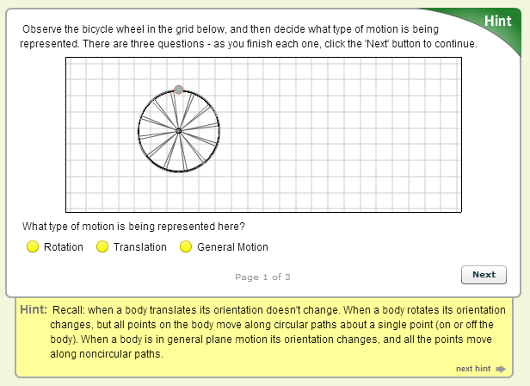
Hints: Example

Slide 24
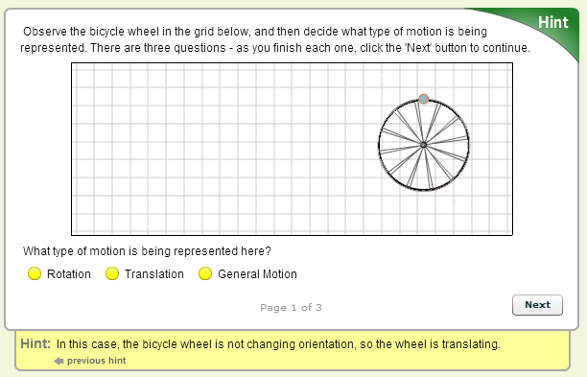
Hints: Example

Slide 25
Feedback
Initial response, then short explanation.
Not quite right: This is not quite right. As you look at the histogram, notice that the distribution is roughly symmetric.
Good job!: Good job! Since the distribution is symmetric, the mean and median would be about the same.
Appropriate distracters:
Reflect common misconceptions or errors,
Aligned to thought process you want students to develop

Slide 26
Feedback: Example

Slide 27
Theory and Research-based Principles of Learning (1)
Prior knowledge can help or hinder learning.
Goal-directed practice and targeted feedback are critical to learning.
The way students organize knowledge determines how they use it.
Mastery involves developing component skills and knowledge, and synthesizing and applying them appropriately.

Slide 28
Theory and Research-based Principles of Learning (2)
Self-directed learning requires that students monitor, evaluate and adjust their approaches to learning.
Motivation generates, directs, and sustains learning behavior.
Students develop holistically and are affected by the social and emotional aspects of the classroom climate.

Slide 29
Example
The way students organize knowledge determines how they use it.

Slide 30
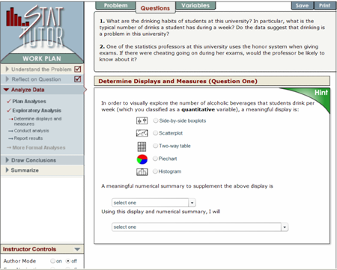
Example
Mastery involves developing component skills and knowledge, and synthesizing and applying them appropriately.

Slide 31
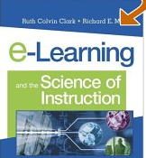
Principles of E-Learning
Multimedia
Contiguity
Coherence
Modality
Redundancy
Personalization
Clark, R. & Mayer, R., e-Learning and the Science of Instruction: Proven Guidelines for Consumers and Designers of Multimedia Learning, 2005

Slide 32
Multimedia Principle
Which is better for student learning?
A. Learning from words and pictures
B. Learning from words alone
Example: Description of how lightning works with or without a graphic
A. Words & pictures
Why?
Students can mentally build both a verbal & pictorial model & then make connections between them

Slide 33
Contiguity Principle
Which is better for student learning?
A. When corresponding words & pictures are far from each other on the page or screen
B. When corresponding words & pictures are presented near each other on the page or screen
Example: “Ice crystals” label in text off to the side of the picture or next to cloud image in the picture

Slide 34
Contiguity Principle
B. Near
Why?
Students do not have to use limited mental resources to visually search the page. They are more likely to hold both corresponding words & pictures in working memory & process them at the same time to make connections.

Slide 35
Modality Principle
Which is better for student learning?
Spoken narration & animation
On-screen text & animation
Example: Verbal description of lightning process is presented either in audio or text

Slide 36
Modality Principle
Spoken narration & animation
Why?
Presenting text & animation at the same time can overload visual working memory & leaves auditory working memory unused.

Slide 37
Redundancy Principle
Which is better for student learning?
Animation & narration
Animation, narration, & text
Example: The description of lightning occurs in pictures, is spoken. Text with the same words is present or not.

Slide 38
Redundancy Principle
Animation & narration
Why?
Text & animation are both processed in visual working memory & may overload it. Further, students eyes may be looking at the text when they should be looking at the animation.

Slide 39
Personalization Principle
Which is better for student learning?
A. Formal style of instruction.
B. Conversational style of instruction
Example: “Exercise caution when opening containers that contain pyrotechnics” vs. “You should be very careful if you open any containers with pyrotechnics”

Slide 40
Personalization Principle
Which is better for student learning?
A. Formal style of instruction.
B. Conversational style of instruction
Example: “Exercise caution when opening containers that contain pyrotechnics” vs. “You should be very careful if you open any containers with pyrotechnics”

Slide 41
Personalization Principle
B. Conversational
Why?
Humans strive to make sense of presented material by applying appropriate processes. Conversational instruction better primes appropriate processes because when people feel they are in a conversation they work harder to understand material.
Conversational style uses words that are more familiar to students & thus they are better able to construct new knowledge by building on prior knowledge.

Slide 42
“Improvement in Post Secondary Education will require converting teaching from a ‘solo sport’ to a community based research activity.”
—Herbert Simon

